Slide 1
Developing React Web Parts
Notes:
This module moves beyond SPFX fundamentals to examine the process of developing SPFX Web Parts for real-world scenarios. The module explains how to develop React Web Parts with a design that coordinates the movement of data between the Web Part class which defines persistent properties and the React component class which defines state. The module also teaches students how to leverage the Office UI Fabric React library to create a user interface using standard React components such as PrimaryButton, TextField and DetailsList. The module demonstrates how to develop Web Parts which use the SharePoint REST API to create new SharePoint lists and to update and query SharePoint list items. Along the way, students will learn essential SPFX programming techniques for executing calls asynchronously and for updating the user interface with a loading indicator whenever the user is waiting for a call to return from across the network.

Slide 2
Agenda
Designing and Developing React Web Parts
Web Part Properties versus React Component State
Leveraging the Office UI Fabric React Library
Developing Web Parts using the SharePoint REST API

Slide 3
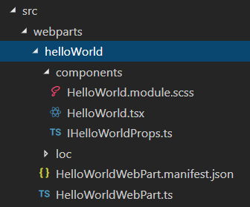
Creating a React Webpart
You can select React as framework for your webpart
You can create a React webpart when creating new project
You can add React webpart to existing project
React webpart made up of several different source files
React component SCSS module
React component class
React component properties interface
Webpart manifest
Webpart class

Slide 4
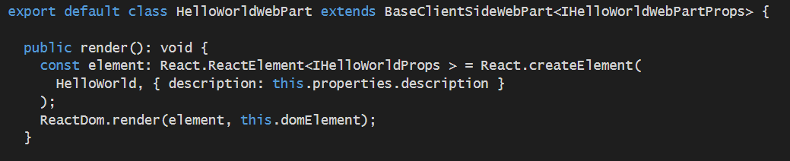

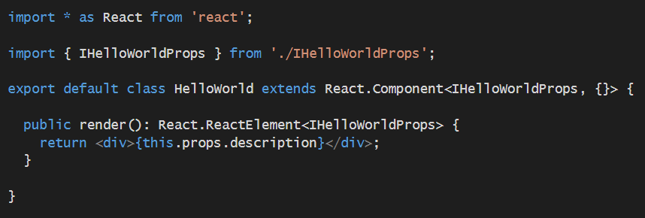
React Webpart Architecture
Webpart class instance
React component instance
React.CreateElement
description

Slide 5
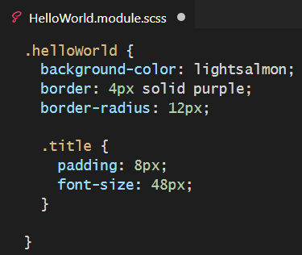
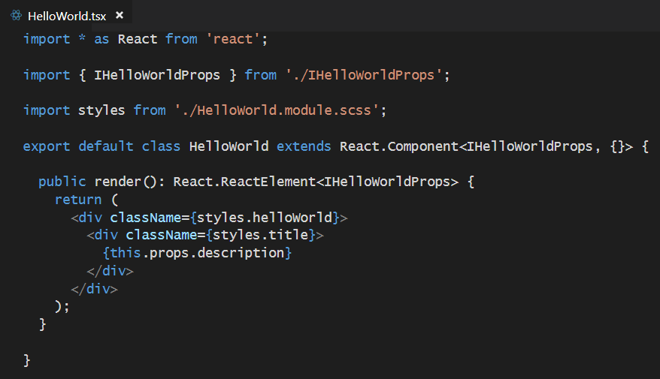
React Webpart Styling

Slide 6
Agenda
Designing and Developing React Web Parts
Web Part Properties versus React Component State
Leveraging the Office UI Fabric React Library
Developing Web Parts using the SharePoint REST API

Slide 7
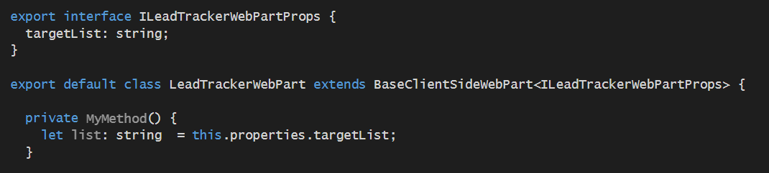
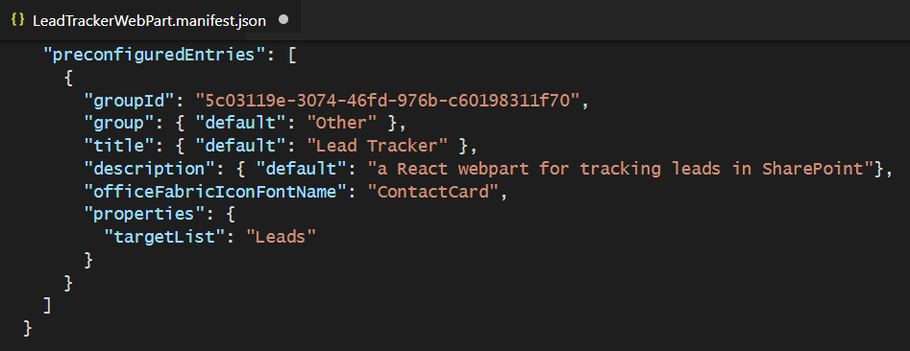
Webpart Persistent Properties
Persistent properties defined in webpart using interface
Property default values add to webpart manifest
LeadTrackerWebPart
Webpart instance
persistent
properties

Slide 8

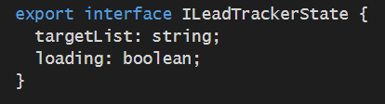
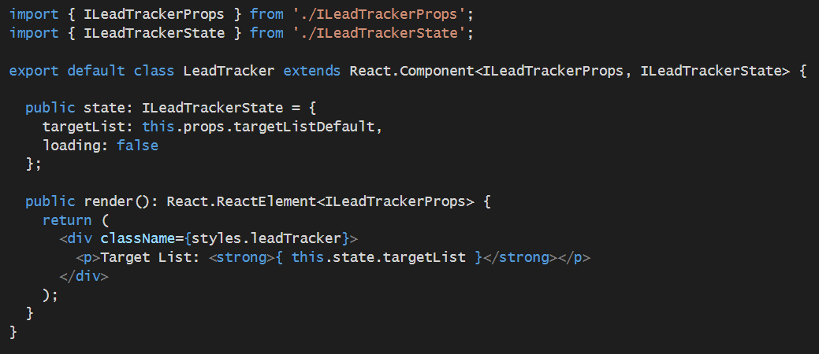
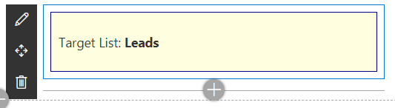
Designing the React Component
LeadTracker
React component

Slide 9
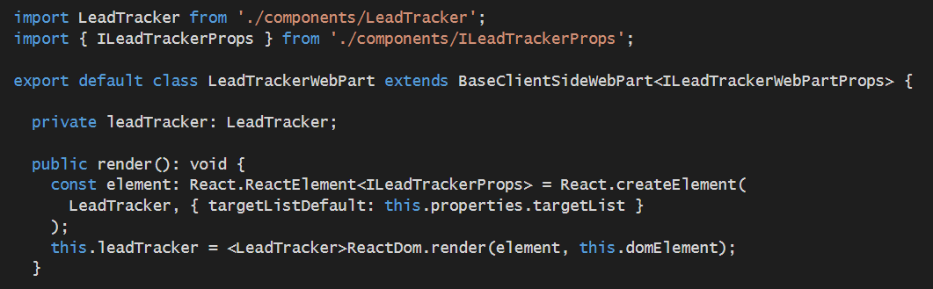
Referencing the React Component Instance
LeadTrackerWebPart
Webpart instance
LeadTracker
React instance
leadTracker

Slide 10
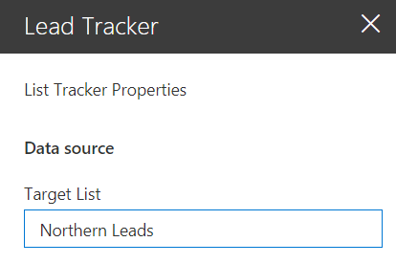
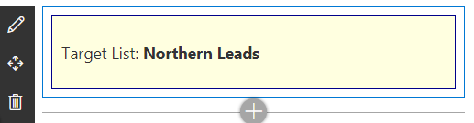
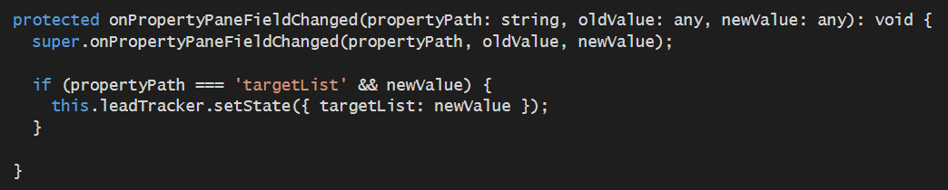
Synchronizing React State with Webpart Properties
Automatic updates
LeadTrackerWebPart
Webpart instance
LeadTracker
React instance
React.Component.setState
targetList

Slide 11
Agenda
Designing and Developing React Web Parts
Web Part Properties versus React Component State
Leveraging the Office UI Fabric React Library
Developing Web Parts using the SharePoint REST API

Slide 12
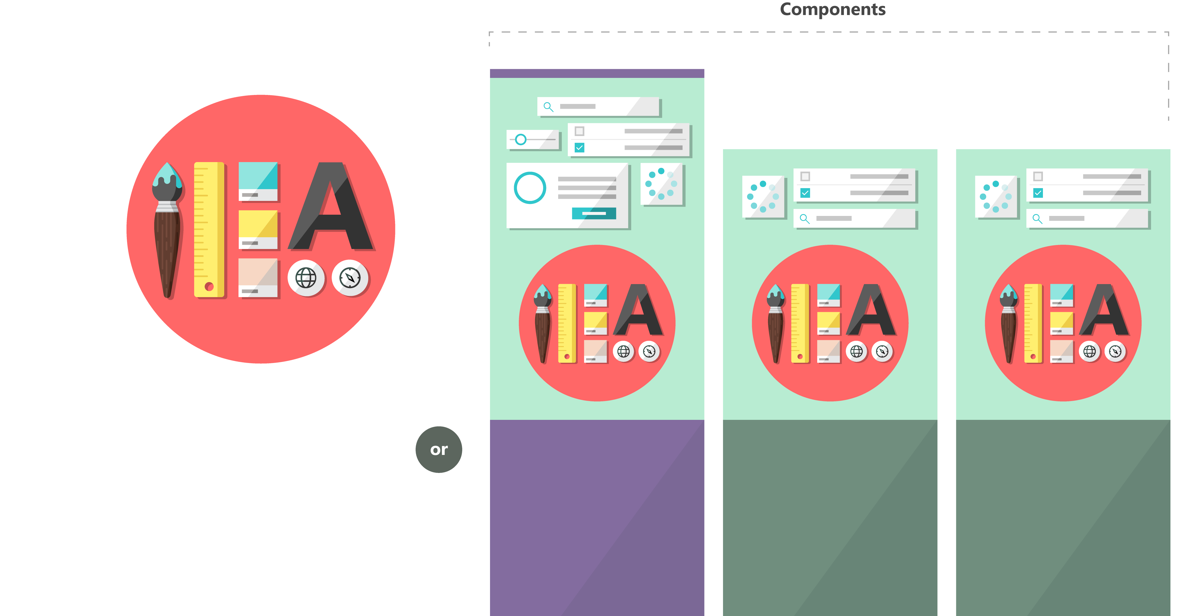

What is the Office UI Fabric?
Office UI Fabric is responsive, mobile-first, front-end style framework
Built by Microsoft to style Office 365, OneDrive and SharePoint sites
All about styling instead of JavaScript
Can be used by 3rd party developers
Fabric Core
Fabric React
Fabric JS
ngFabric
Fabric iOS
Core elements of the design language including icons, colors, type, and the grid
Robust, up-to-date components built with the React framework.
Simple, visuals-focused components that you can extend, rework, and build on.
Community-driven project to build components for Angular-based apps.
Native Swift colors, type ramp, and components for building iOS apps.

Slide 13
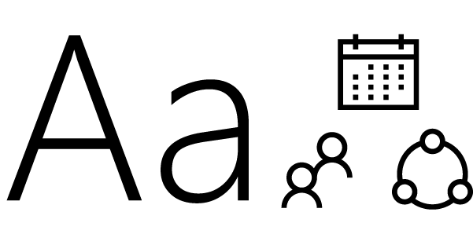
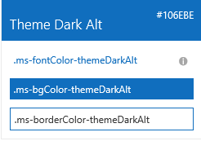

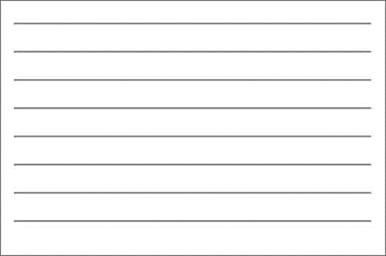

Fabric Core styling
Fonts and typography
Segoe font family + type ramp
Official Office 365 iconography
Color
Official Office 365 color palette
Branded assets
Product symbols + product filetype symbols
Animations
Official Office 365 selection of easings and animations
Responsive grid
Tailored to Office 365 silhouettes

Slide 14
Styles
The Office UI Fabric provides styles for..
Typography
Color
Icons
Animations
Responsive Grid
Localization

Slide 15
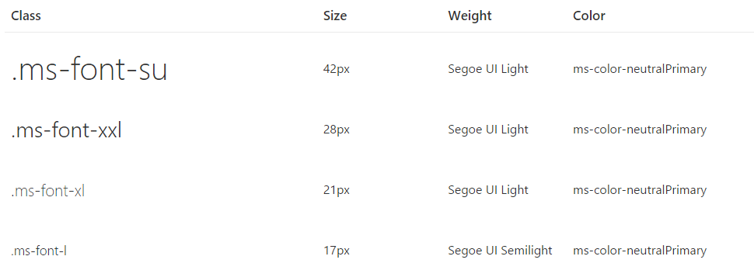
Typography
Base font classes
Fabric includes 10 base font classes
Each base class sets a default size, weight, and color.

Slide 16
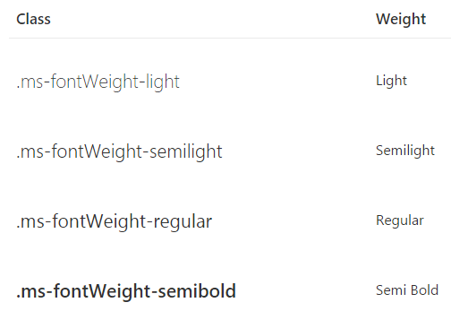
Typography
Helper font classes
There are helper font classes to change the text weight.

Slide 17
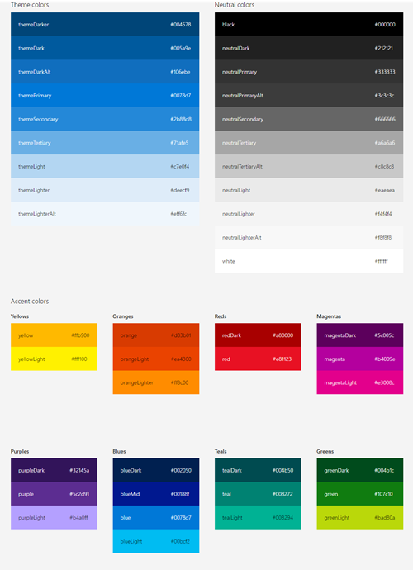
Color
Includes 9 theme colors and 11 neutral colors.
Helper classes for text, border, background, and hover states.
Color classes act as hooks into the Office 365 theming system

Slide 18
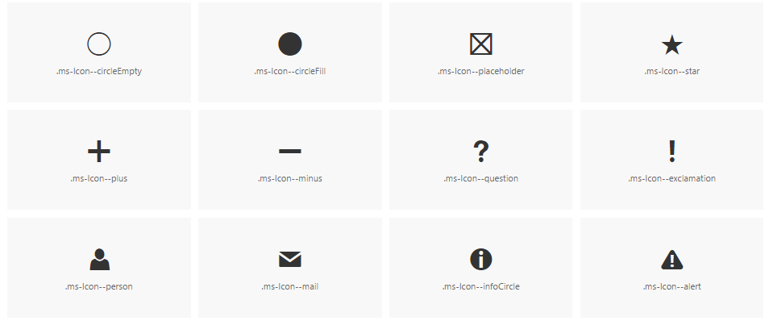
Icons
Fabric uses a custom font for its iconography.
Font contains glyphs you can scale, color, and style

Slide 19
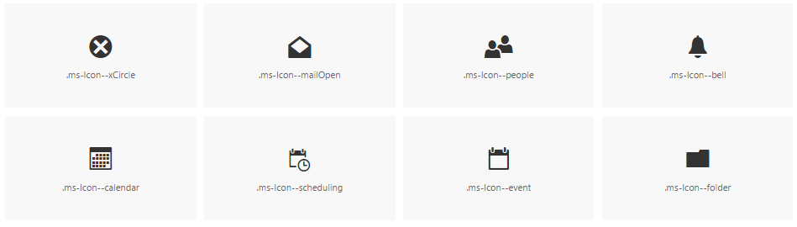
Icons
To use the icons, combine the base ms-Icon class with a modifier class for the specific icon.
<i class="ms-Icon ms-Icon--mail" aria-hidden="true"></i>

Slide 20
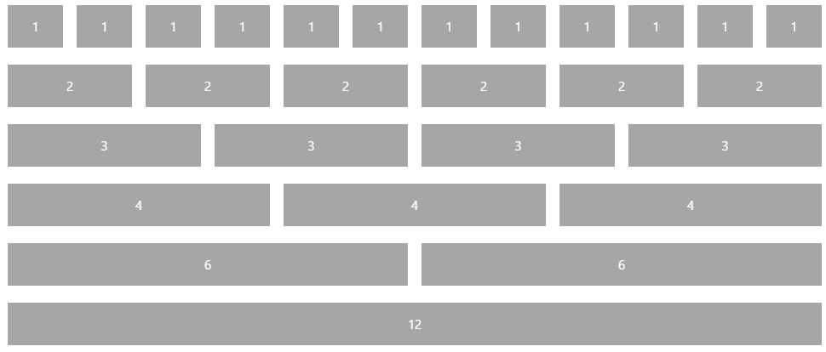
Responsive Grid
Fabric comes with a mobile-first, responsive grid
Based on 12 column grid
Used to create flexible layouts
<div class="ms-Grid">
<div class="ms-Grid-row">
<div class="ms-Grid-col ms-u-sm6 ms-u-md4 ms-u-lg2">First</div>
<div class="ms-Grid-col ms-u-sm6 ms-u-md8 ms-u-lg10">Second</div>
</div>
</div>

Slide 21
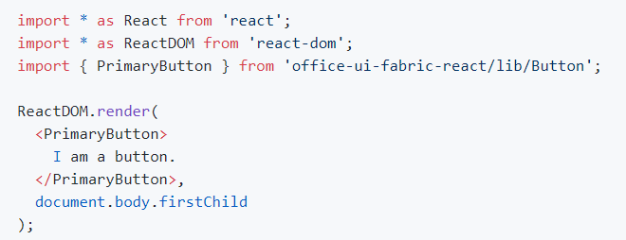
Office UI Fabric React Components
Fabric's React components are building blocks for UI
Components can be used in general React development
Components can be used in SharePoint Framework development

Slide 22
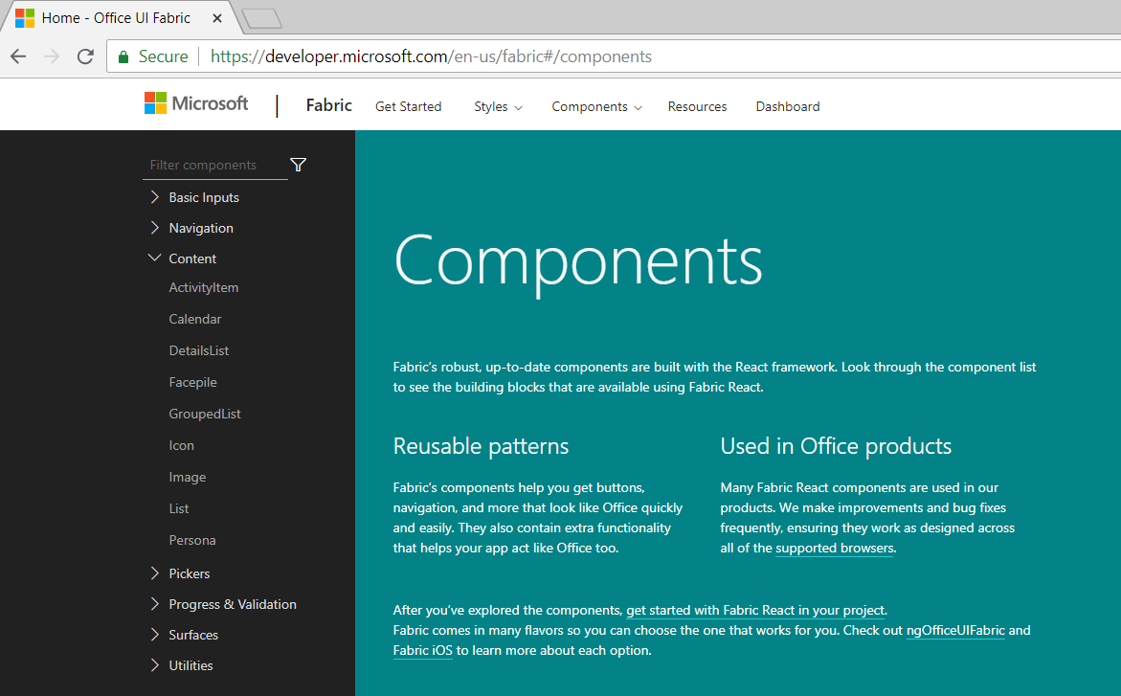
Office UI Fabric React Component Library
https://developer.microsoft.com/en-us/fabric#/components

Slide 23
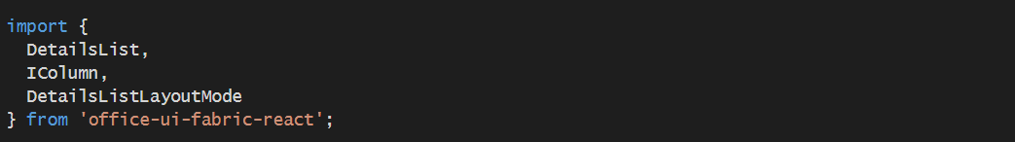
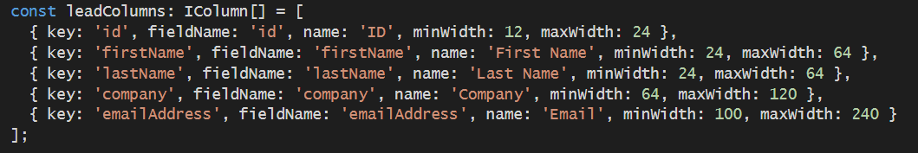
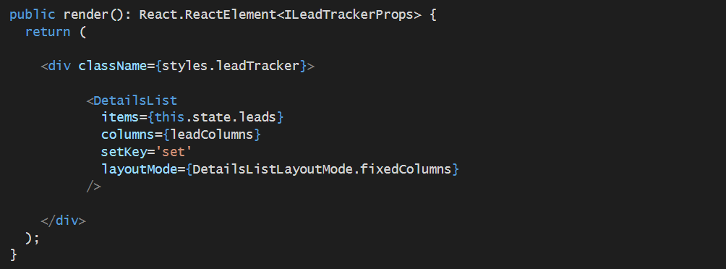
Using the DetailsList Component

Slide 24
Agenda
Designing and Developing React Web Parts
Web Part Properties versus React Component State
Leveraging the Office UI Fabric React Library
Developing Web Parts using the SharePoint REST API
Designing Web Parts to Manage SharePoint Lists

Slide 25
RESTful Web Services
RESTful Web Service
implemented using the principles of REST
REST URI = [base URI] + [resource path] + [query options]
Calls based on standard HTTP verbs (GET, POST, PUT, DELETE)
Passes data to and from client using representations
Can be designed to implement custom APIs and/or standard APIs
Data passed across network using representations
Representations model resources – but they’re different
Based on common formats: HTML, XML, ATOM and JSON
Based on specific Internet media types

Slide 26
OData Primer
What is OData?
A standardized REST API interface for common CRUD operations
Defined by Open Data Protocol specification
OData services becoming more popular on Internet (e.g. NetFlix)
SharePoint 2010 introduced a REST API for dealing with list items
SharePoint 2013 introduces new and expanded REST API
for an excellent resource go to
http://www.odata.org
Notes:
OData is quickly becoming the industry’s new data access API. It’s popularity is based on the fact that it is the first mainstream data access API for HTTP-based Clients. OData serves to standardize performing CRUD (Create, Read, Update, Delete) operations from across the network using HTTP verbs such as GET, PUT and POST.
OData services are becoming more popular on the Internet. Examples of OData services include NetFlix, Dallas, and the Azure Data Mart. Client application such as Excel 2010 and Excel 2013 are examples of client application that can consume data from any OData-based data source.

Slide 27
OData Query Option Parameters
$select
http://services.odata.org/OData/OData.svc/Products?$select=Price,Name
$filter
http://services.odata.org/OData/OData.svc/Products?$filter=startswith(CompanyName, 'Alfr')
$orderby
http://services.odata.org/OData/OData.svc/Products?$orderby=Rating
$top
http://services.odata.org/OData/OData.svc/Products?$top=5
$skip
http://services.odata.org/OData/OData.svc/Products?$skip=5
http://services.odata.org/OData/OData.svc/Products?$skip=5&$top=5
$expand
http://services.odata.org/OData/OData.svc/Categories?$expand=Products

Slide 28
Using the $filter Parameter

Slide 29
$filter Parameter String Functions

Slide 30
Remote Communications with SharePoint
In SharePoint 2003 and SharePoint 2007
SOAP-based web services (e.g. Lists.asmx)
In SharePoint 2010
Client-side Object Model (CSOM)
REST API for list items accessible through ListData.svc
In SharePoint 2013
Expanded CSOM Support
New SharePoint REST API replaces ListData.svc
In SharePoint 2016 and SharePoint Online
REST API improved with greater support for ODATA 4.0
Notes:
The SharePoint client-side object model (CSOM) debuted in SharePoint 2010 where it was made available as a WFC entry point named client.svc. However, SharePoint 2010 did not support developers accessing client.svc directly. Instead, the developer uses client-side proxy objects exposed by either a .NET assembly or a JavaScript library.

Slide 31
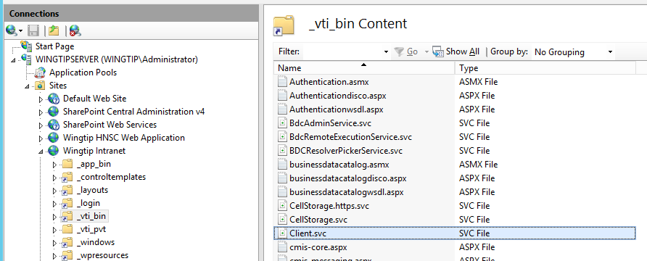
SharePoint REST API Architecture
REST API entry point is client.svc
In SharePoint 2010, client.svc only used by CSOM
Since SharePoint 2013, client.svc used by CSOM and REST API
REST API Client
client.svc
CSOM Client

Slide 32
SharePoint REST URLs and the _api Alias
SharePoint REST API provides _api alias
The _api alias maps to _vti_bin/client.svc
Alias used to make SharePoint REST API URLs cleaner
Alias serves to decouple URLs from underlying architecture
This URL works but it is not recommended
http://intranet.wingtip.com/_vti_bin/client.svc/web
SharePoint REST API URLs should be created with _api
http://intranet.wingtip.com/_api/web
Notes:
In SharePoint 2016 the Service root URI contains the URI to the target SharePoint site and then the relative path to the client.svc entry point inside the _vti_bin virtual directory. After that you add the resource path to specify an object such as a site or list. Here's an example of a resource path for the current site.
http://wingtipserver/_vti_bin/client.svc/web
SharePoint 2013 allows REST URLs can go through the _api folder which cleans up the look of the URLs that need to be built and removes client.svc file name from URL. The URL below is equivalent to the one above and should be preferred.
http://wingtipserver/_api/web

Slide 33
Anatomy of a SharePoint REST URL
SharePoint REST made up of three parts
Base URI
http://intranet.wingtip.com/_api
Target SharePoint Object
web
Query String Parameter options
?$select=Id,Title,MasterUrl
Notes:
The collection of lists for the current site: /_api/web/lists
Get a specific list by its title: /_api/web/lists/getByTitle('Announcements')
Get all the Web templates within the current site which is based on US English: /_api/web/getAvailableWebTemplates(lcid=1033)
Refer to the following article on MSDN, specifically figure 9, to see how SharePoint constructs REST URLs:
http://msdn.microsoft.com/en-us/library/office/apps/fp142385(v=office.15).aspx
A fantastic resource for the detailed documentation for all REST APIs can be found in the protocol documents:
Web Versions:
http://msdn.microsoft.com/en-us/library/cc339475(v=office.12).aspx
ZIP of all protocol docs as PDFs:
http://download.microsoft.com/download/8/5/8/858F2155-D48D-4C68-9205-29460FD7698F/SharePointProtocols.zip

Slide 34
Mapping SharePoint Objects to URLs
SharePoint Object | Object mapping
Site Collection | site
Site | web
Lists collection | web/lists
List by ID | web/lists(guid'402cd788-9c5c-4931-92d6-09f18efb368c')
List by Title | web/lists/getByTitle('Customers')
List property | web/lists/getByTitle('Customers')/Title
List items collection | web/lists/getByTitle('Customers')/items
List item | web/lists/getByTitle('Customers')/items(1)
List item property | web/lists/getByTitle('Customers')/items(1)/FirstName

Slide 35
ODATA Formats and the Accept Header
Verbose (aka Full Metadata)
accept: application/json; odata=verbose
Minimal Metadata
accept: application/json; odata=minimalmetadata
accept: application/json
No Metadata
accept: application/json; odata=nometadata

Slide 36
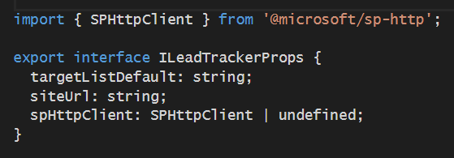
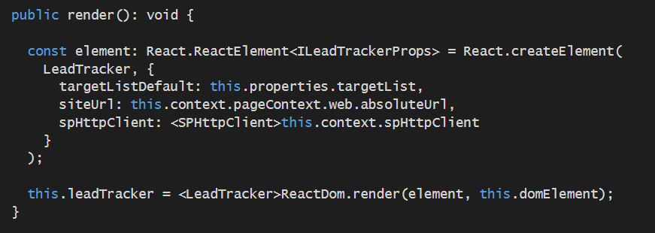
Passing SPHttpClient to the React Component

Slide 37
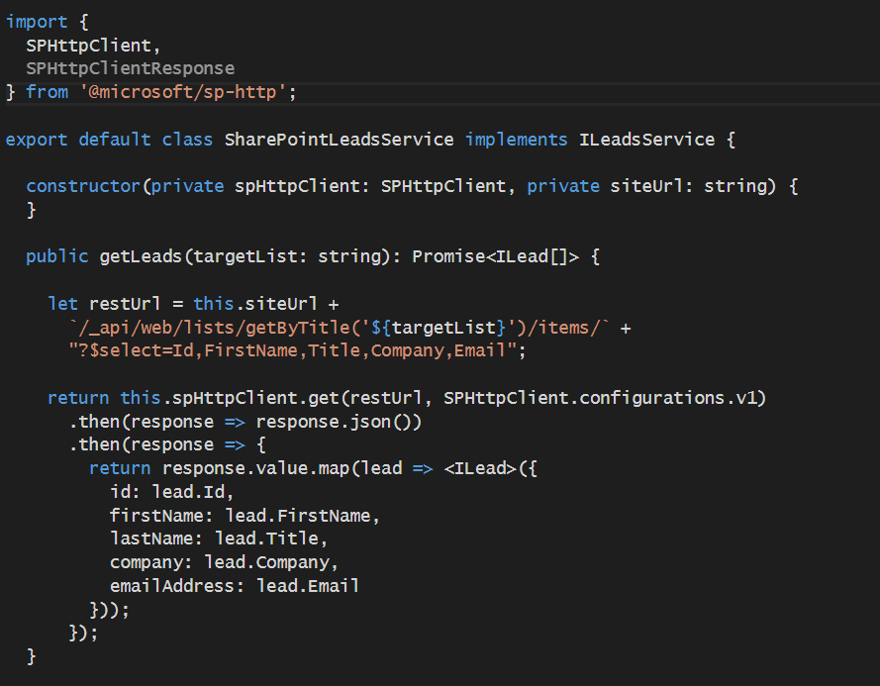
Service Class using SPHttpClient

Slide 38
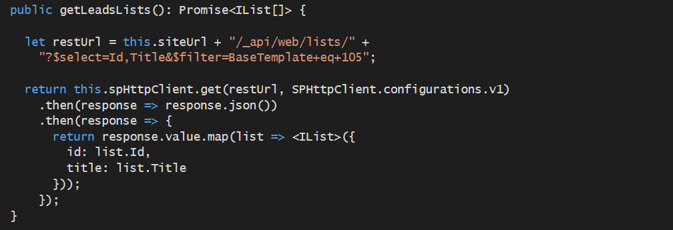
Calling SPHttpClient.get

Slide 39
Agenda
Designing and Developing React Web Parts
Web Part Properties versus React Component State
Leveraging the Office UI Fabric React Library
Developing Web Parts using the SharePoint REST API
Designing Web Parts to Manage SharePoint Lists

Slide 40
Reading Items from a SharePoint List

Slide 41
Summary
Designing and Developing React Web Parts
Web Part Properties versus React Component State
Leveraging the Office UI Fabric React Library
Developing Web Parts using the SharePoint REST API
Designing Web Parts to Manage SharePoint Lists

